Slide 1
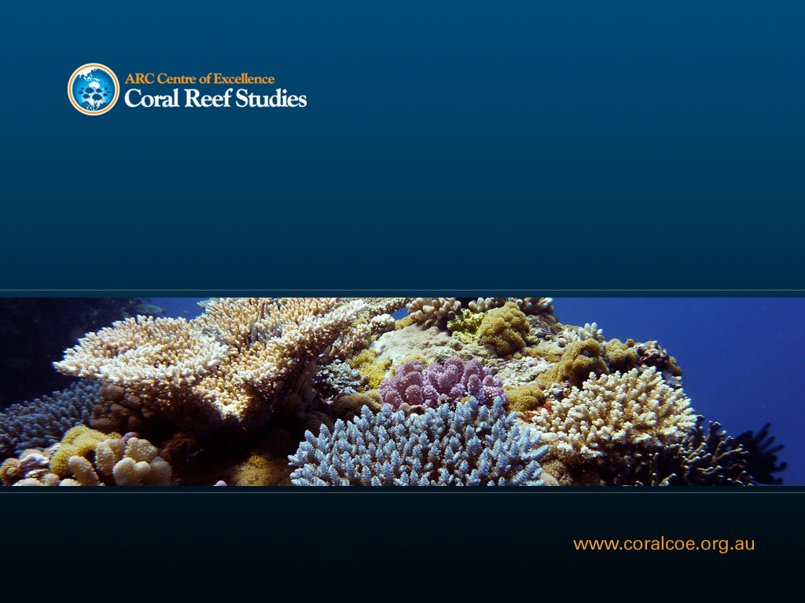
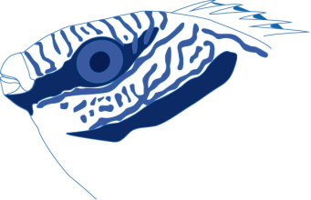


Pair-formation in the herbivorous rabbitfish Siganus doliatus
Simon J. Brandl*† & David R. Bellwood*†
*School of Marine and Tropical Biology, James Cook University
†ARC Centre of Excellence for Coral Reef Studies

Slide 2
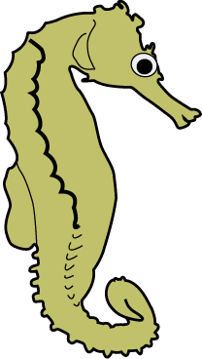
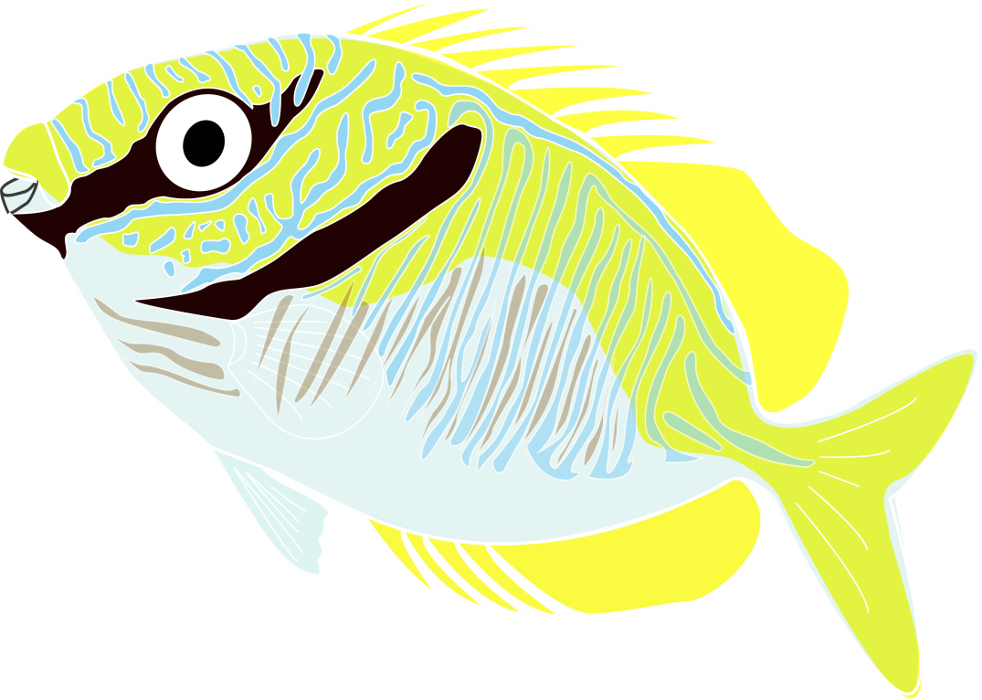

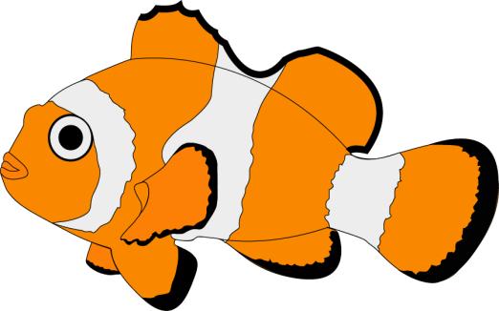

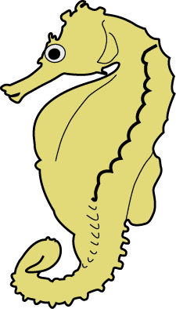

International Coral Reef Symposium 2012

Slide 3
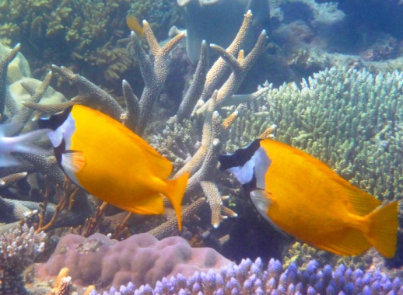
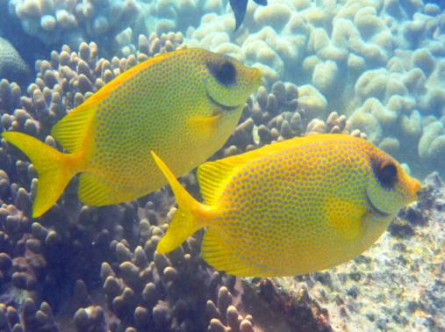
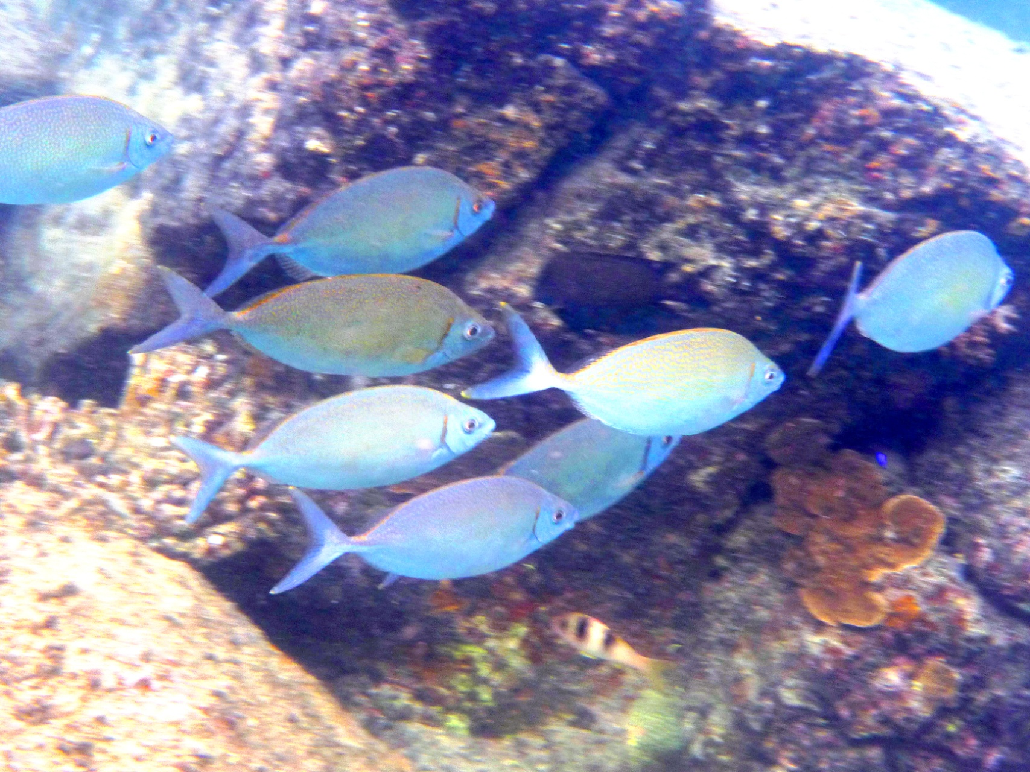
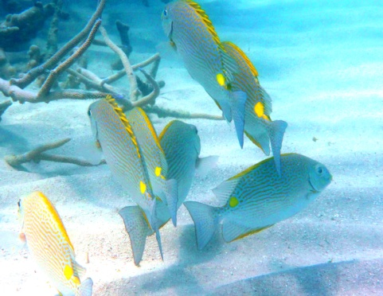
Introduction _{Siganidae}
28 species, 16 pairing
colouration, body shape
herbivorous

Slide 4
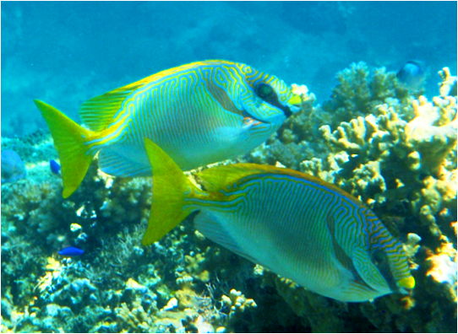
Introduction _{Aims}
1. How common is pair-formation?
2. How tight is the bond between pairs?
3. What is the function of pair-formation?

Slide 5
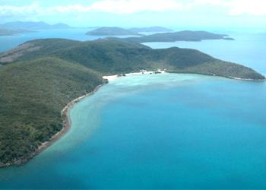
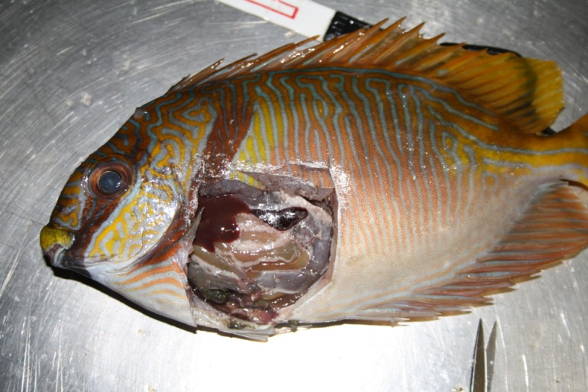
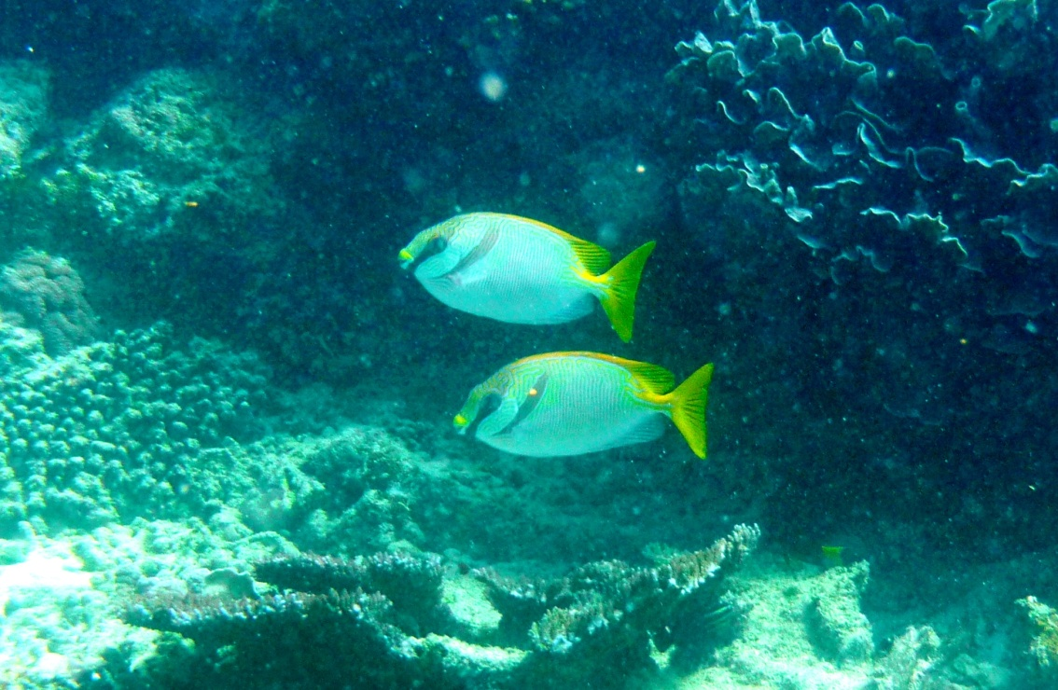

Methods
underwater visual censuses
histology
behavioural observations
acoustic telemetry

Slide 6
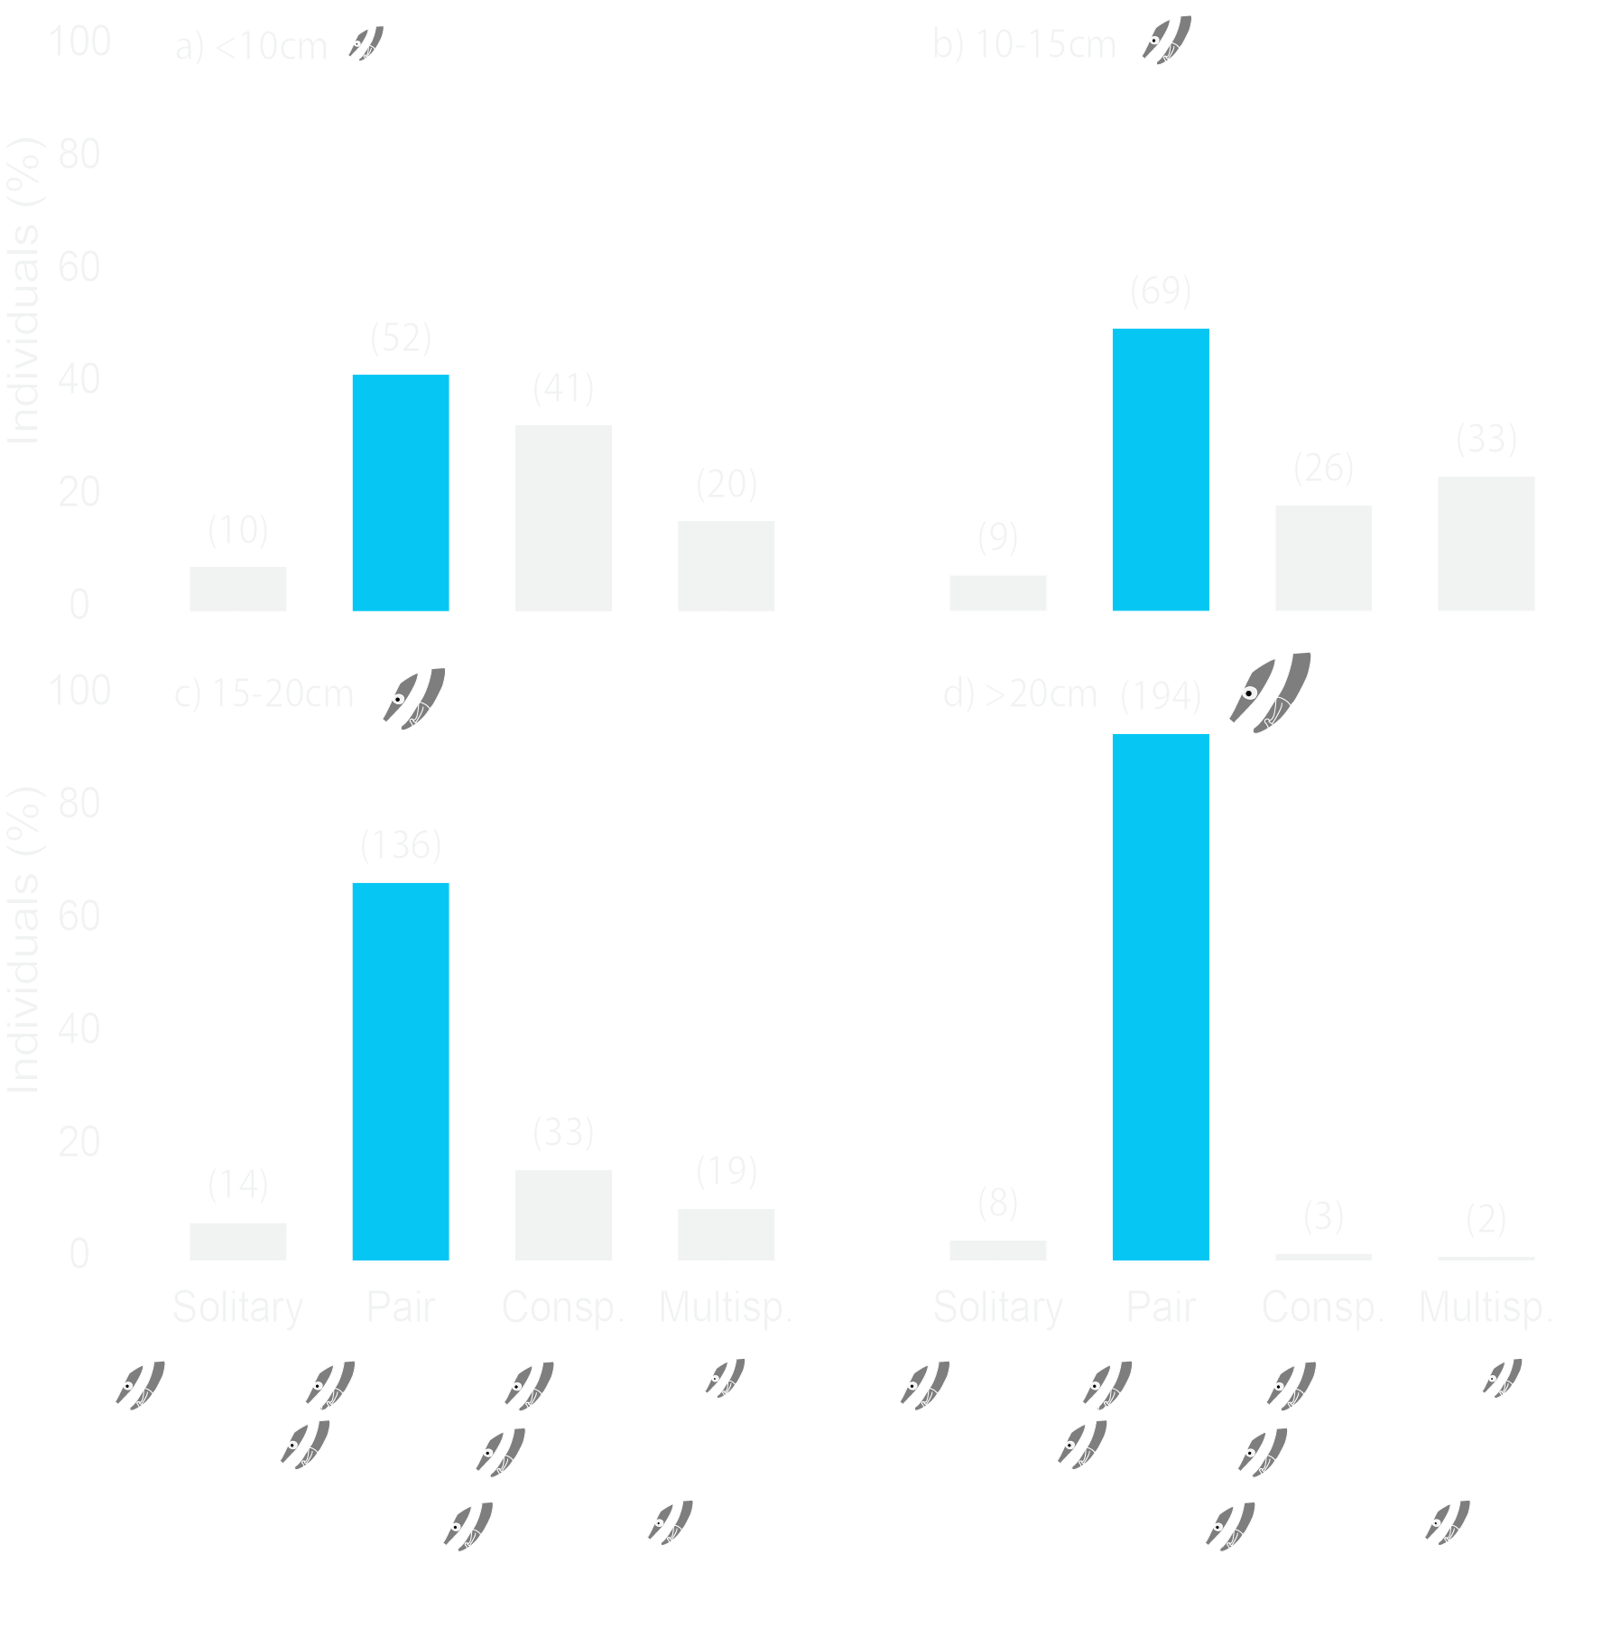
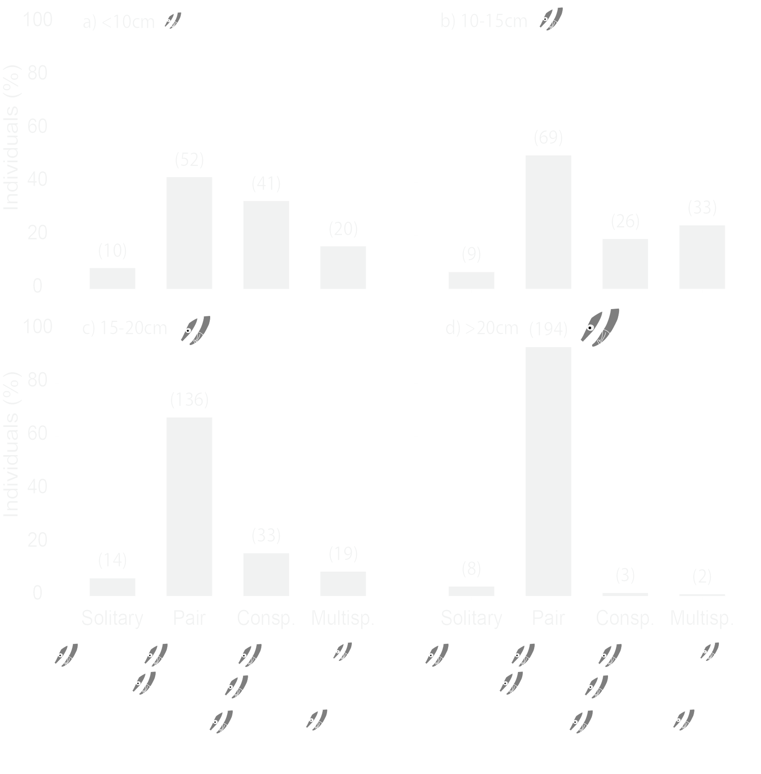
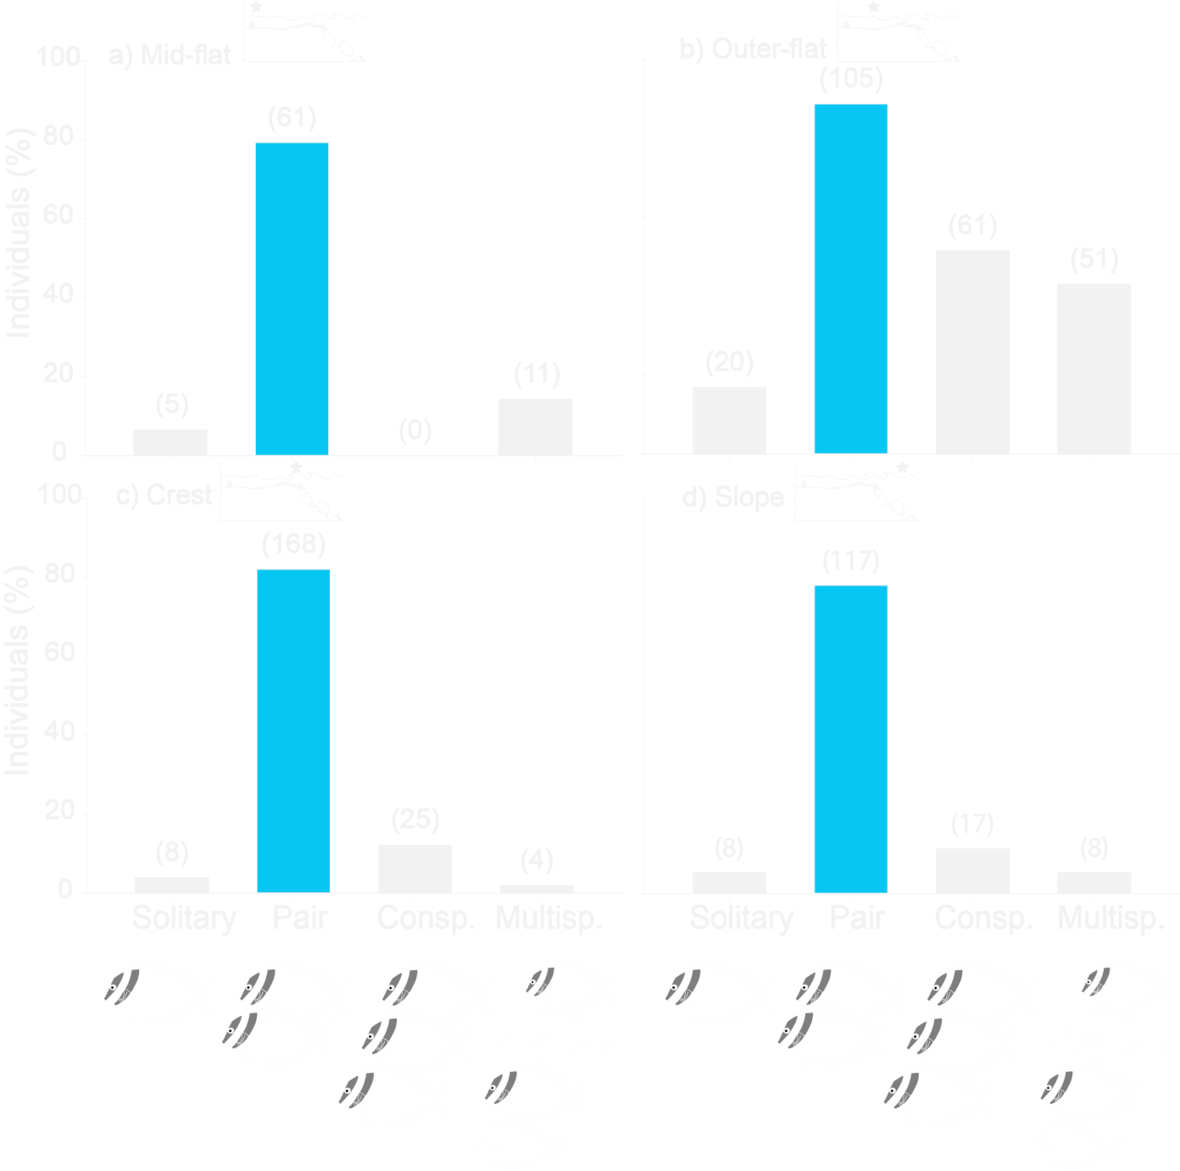



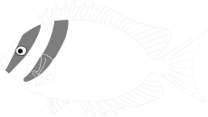
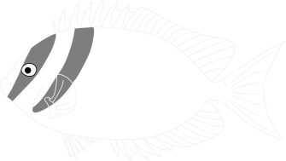
Results and Interpretation _{Pairing}
669 individuals, 451 in pairs (67.4%)
all size classes, all zones but outer-flat
pairing most common social system

Slide 7
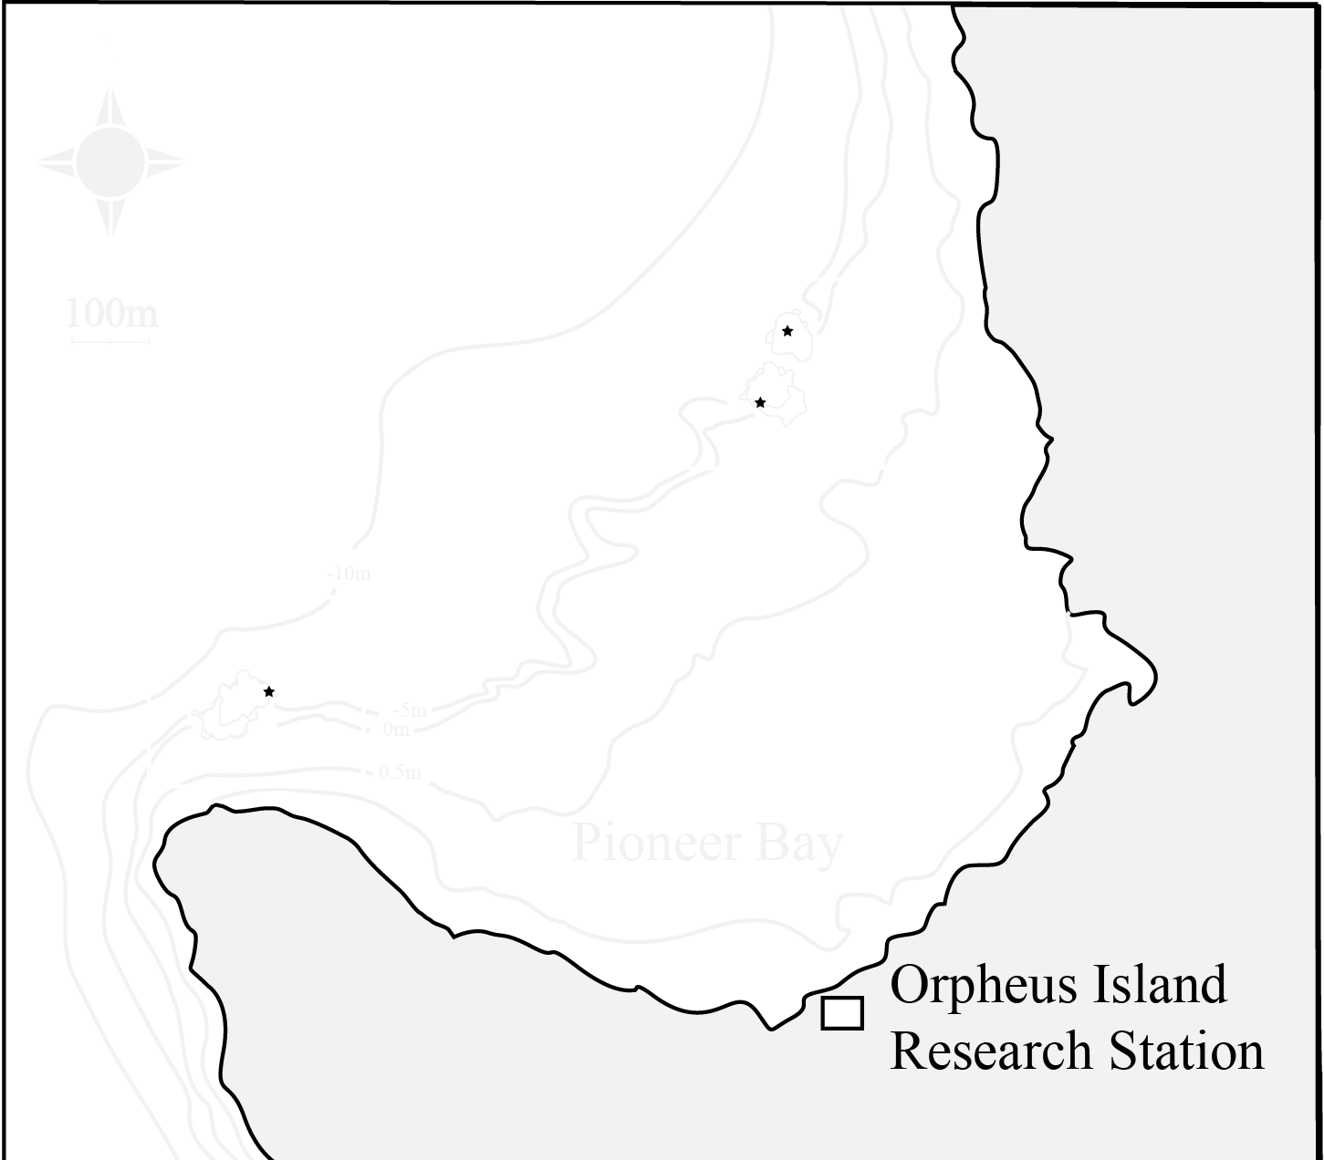
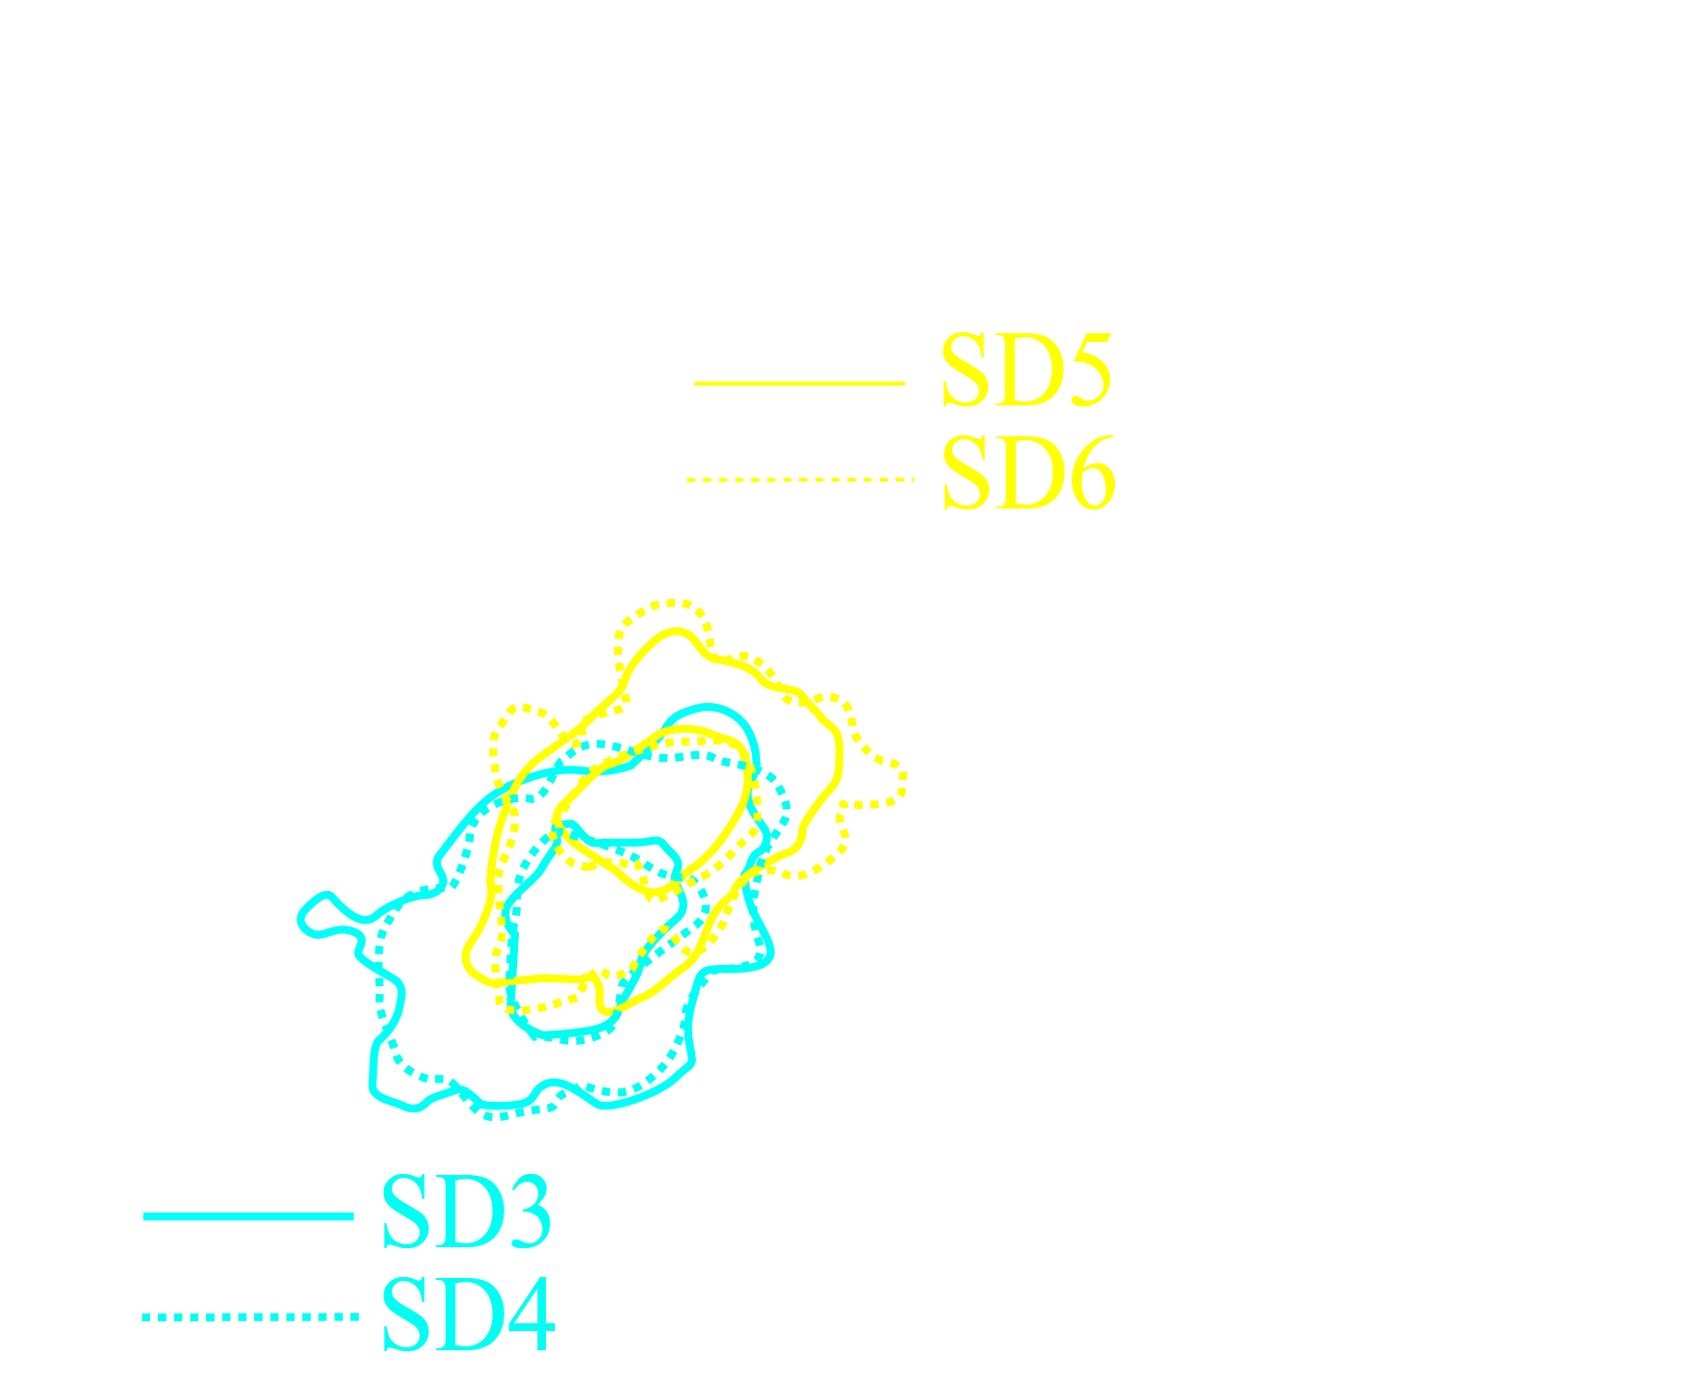
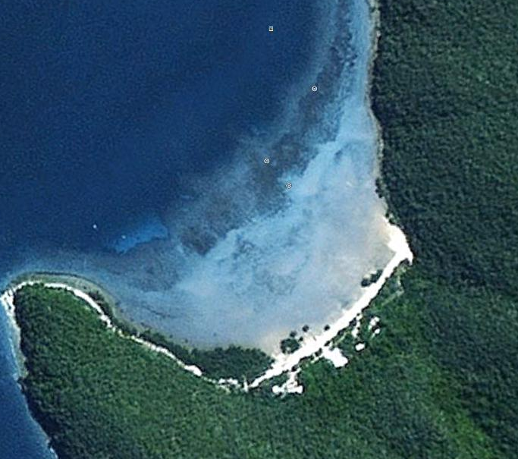
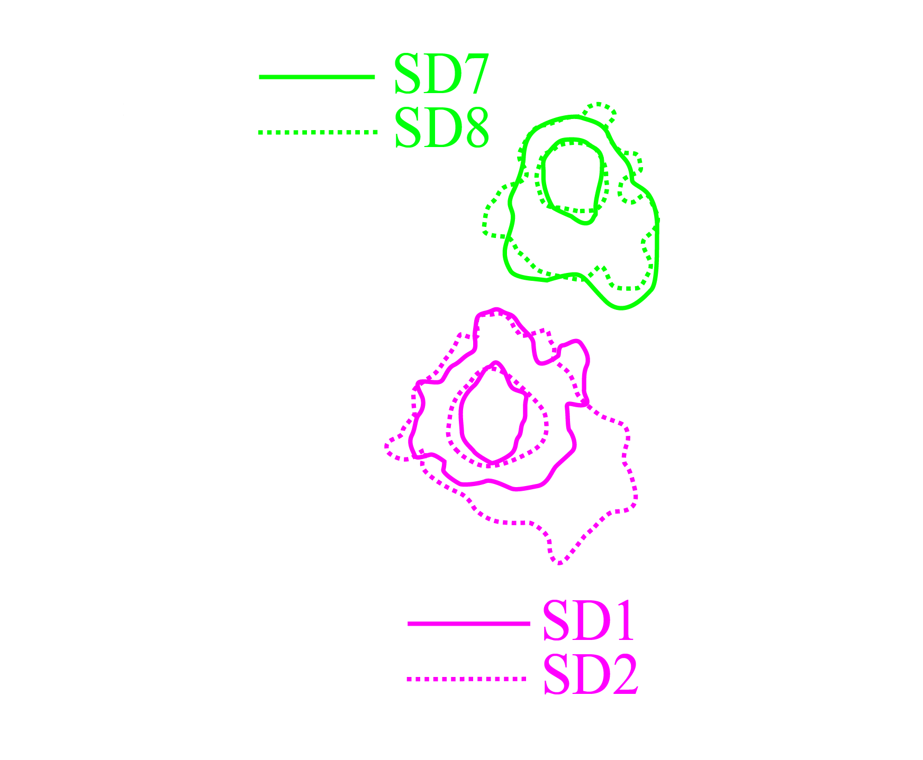
Results and Interpretation _{Pairing}
home range: 1.53 ha
core area: 0.31 ha
mean difference 0.22 ha

Slide 8
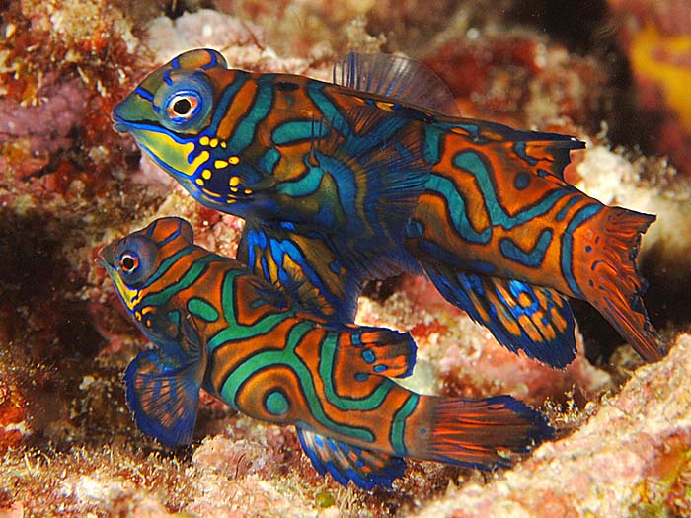
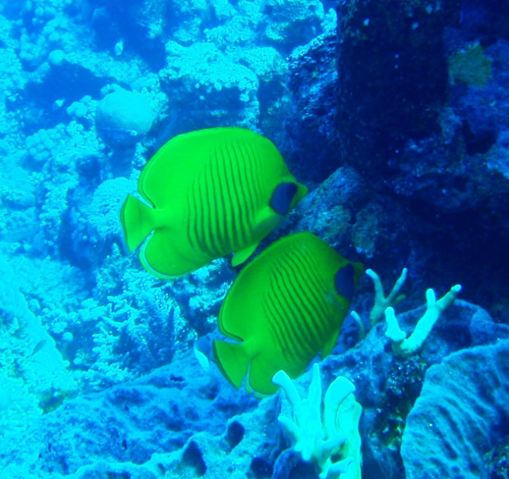
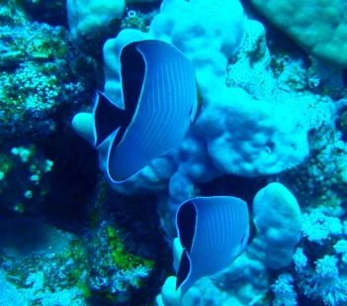
Results and Interpretation _{Reproduction}
reproductive function
pairing almost ubiquitous and high fidelity
maturity-dependent onset of pairs (95% mature)
size differences small (8.6% of TL; r² = 0.7, P < 0.001)

Slide 9

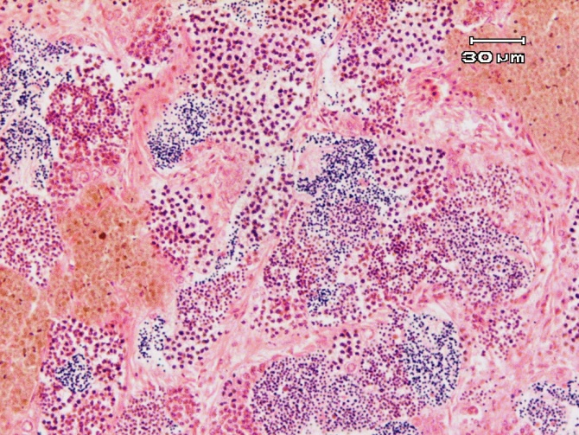
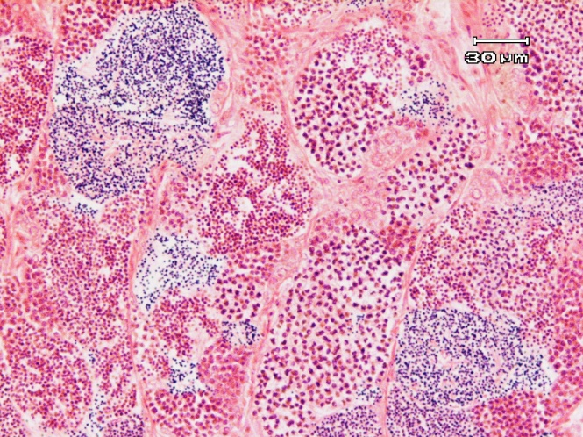
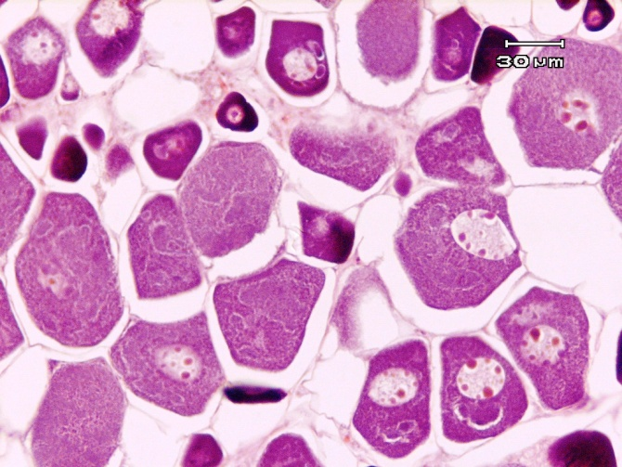
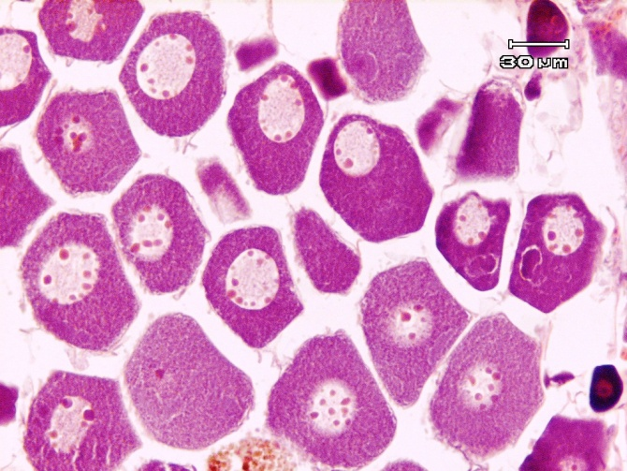

Results and Interpretation _{Pairing}
Pair #17
Pair #4
5 / 20 pairs homosexual, P > 0.5
Reproductive function unlikely!

Slide 10
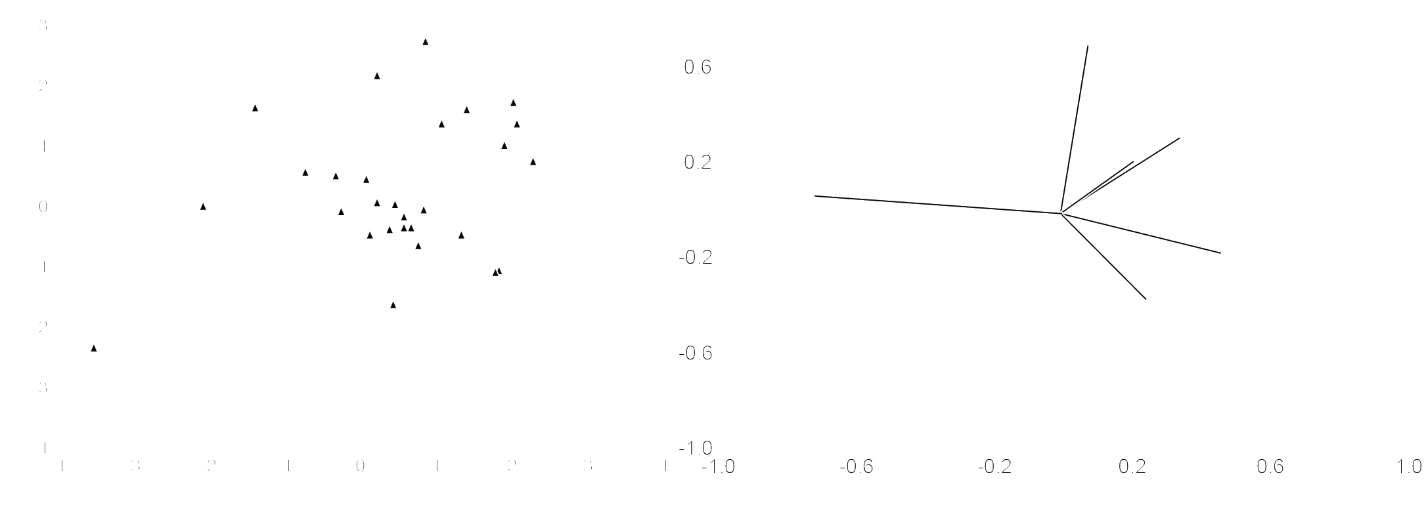
Results and Interpretation _{Pairing}
ecological benefits
behavioural differences

Slide 11
Results and Interpretation _{Ecology}

Slide 12
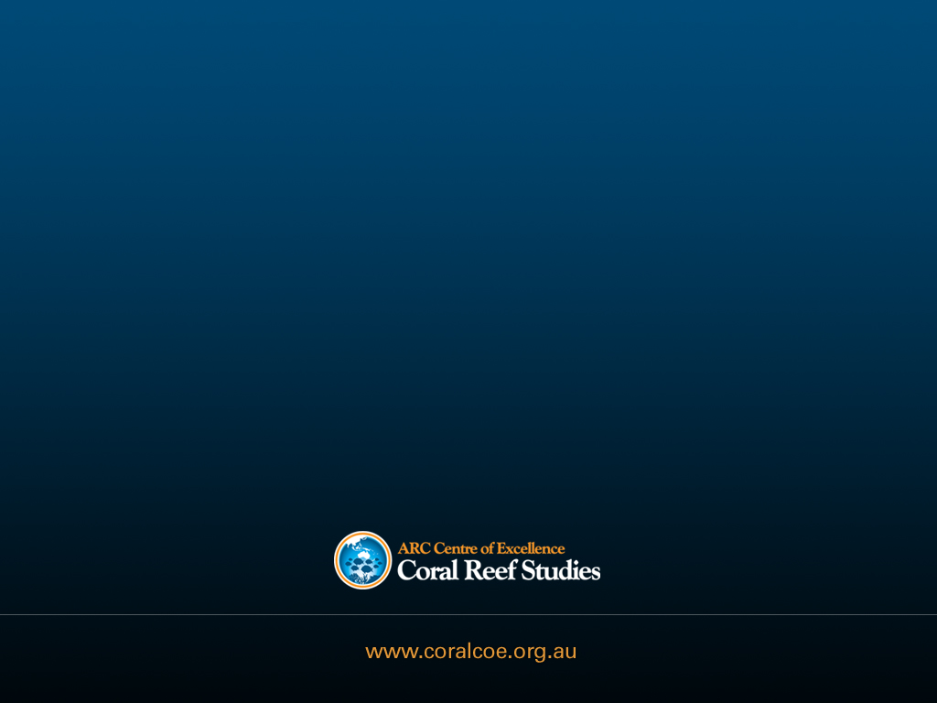
^{Credits}
ARC – Centre of Excellence for Coral Reef Studies, ^{C Goatley,} ^{J Welsh,} ^{J Rizzari,} ^{B Bergseth,} ^{C Lefevre,} ^{S Reilly,} ^{J Tanner,} ^{R Fox,} ^{K} ^{Nicolet,} ^{T Rueger,} ^{M Rocker,} ^{A Hoey,} ^{K Quigley, C Johansson} ^{VEMCO,} ^{OIRS}

